Slide 1


Lecture 11
Chemical Engineering for Micro/Nano Fabrication

Slide 2
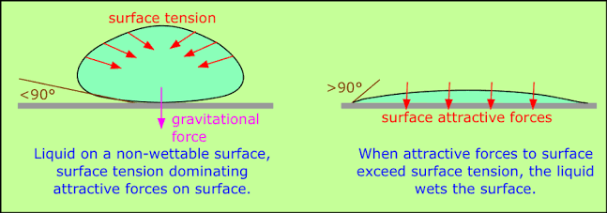
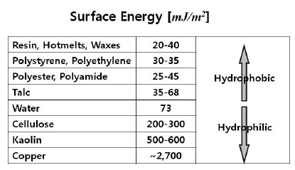
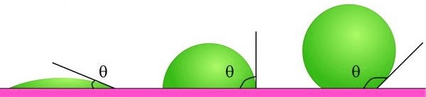
Surface Energy and Surface Tension
Surface Energy
High Medium Low
https://knowledge.ulprospector.com/3354/pc-surface-tension-surface-energy/

Slide 3
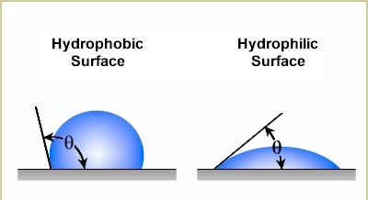
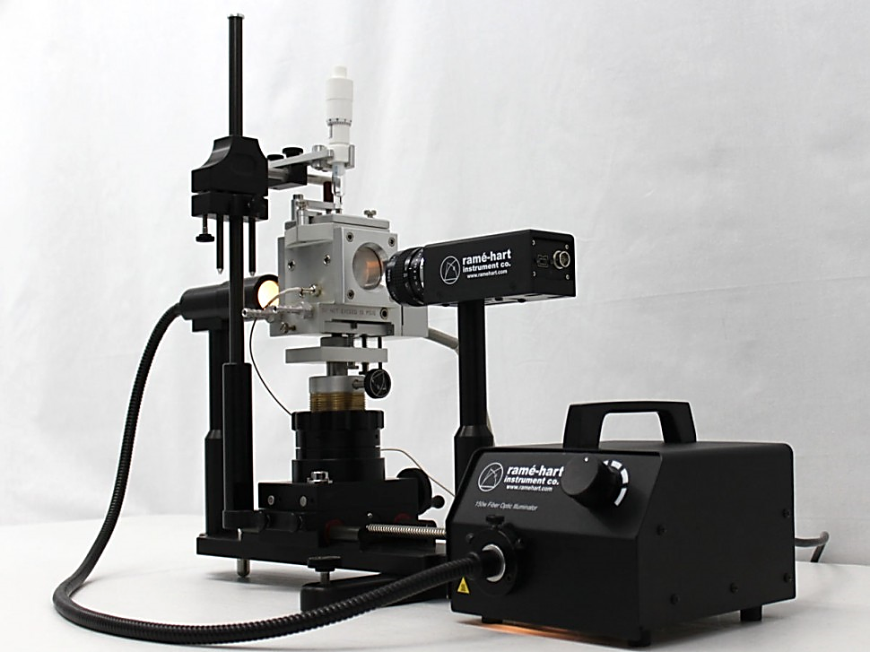
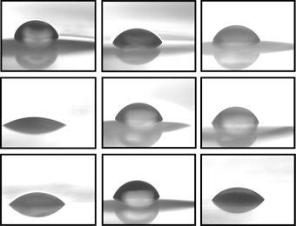
Contact angle and surface energy
goniometer

Slide 4
The silicon resist design for high aspect ratio
Organosilicon imprint with residual layer
Planarizing overcoat
(Ultra-High Si-mat)
SUBSTRATE
organosilicon imprint after residual layer etch
SUBSTRATE
Selective O₂ RIE does not
Etch organosilicon material
High aspect ratio pattern
after selective etch
SUBSTRATE

Slide 5
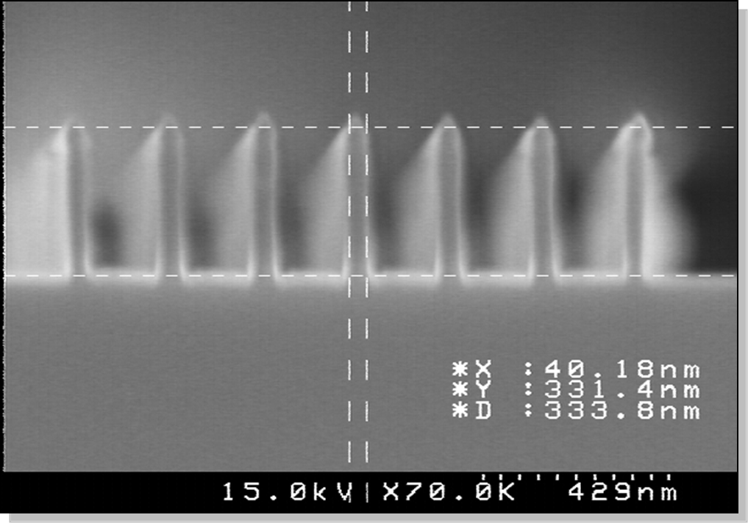
Early imprint results

Slide 6
Imprint Resist Formulation a System Problem
template
Release layer
Adhesion layer:
(covalent bonding with
resist during UV cure)
substrate
Resist: Photopolymerizable monomers initiator and reactive surfactant

Slide 7
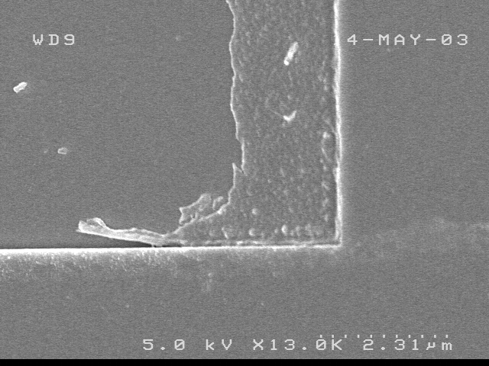
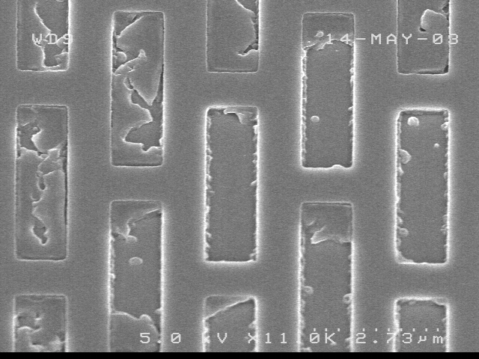
Cohesive vs Adhesive Separation
Material with poor mechanical properties
Fouled Templates due to
Bad Materials Properties
Cohesive Failures call for stronger materials

Slide 8
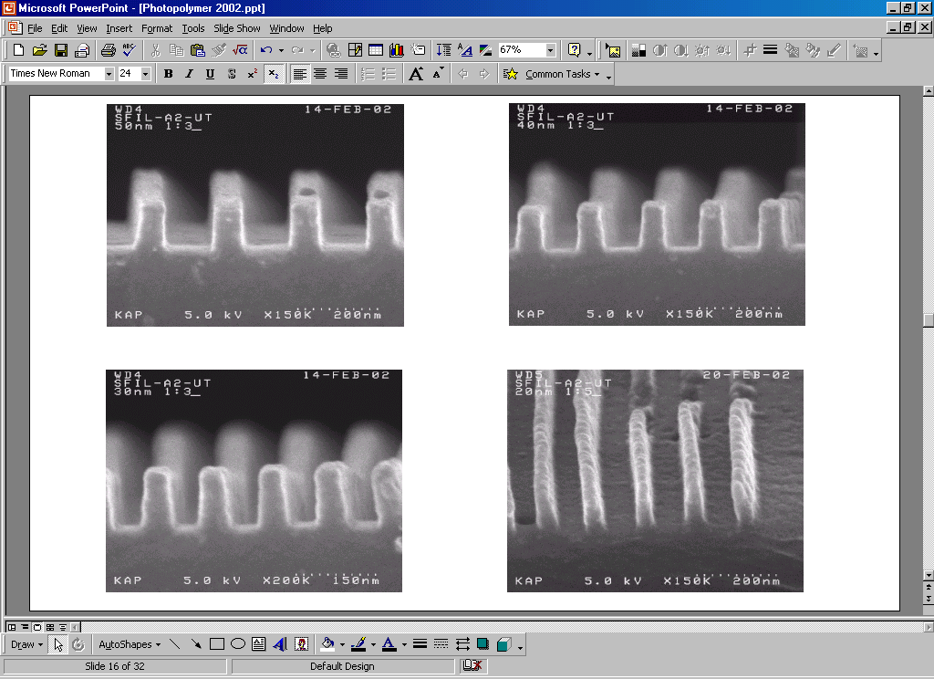
First Etch Barrier Formulation
Si-containing monomer
EGDA
t-BuAc
Darocur 1173
Well defined,
stable structures:
Rapid cure to high conversion:
Low viscosity: 1.9cPs/20C
40nm
30nm

Slide 9






Role of Evaporation in Imprint Process
Thin residual layers and ease of filling require low viscosity & small drops.
High evaporation can lead to:
  Variable mechanical properties of imprint material
  Variation in film thickness
Evaporation of an 80pL Drop of Monomer
Initial Drop | 10 seconds | 20 seconds | 30 seconds | 40 seconds | 50 seconds
70μm
~ 42% material loss
~ 56% material loss
Notes:
-Turn your attention from the dispenser to the drops the it is jetting …
-Low viscosity fluids are inherently volatile and will evaporate, which can create variable mechanical properties of the imprint material and give rise to variation in the residual layer thickness.
-To study evaporation, we use the age sessile drop method shown here…
-After 30sec of evaporation, 42% of the material is loss … how it can influence the mechanical robustness of the imprint
-I will show you an example of how we have addressed this situation …

Slide 10
Re-working etch barrier formulation
SIA0210 44%
EGDA 15%
iBA 37%
Irgacure 4%

Slide 11
Old Stuff
New Stuff
Elongation at break 1-2%
Elongation at break 30-35%
Tensile Modulus 80 MPa
Tensile Modulus 500 MPa

Slide 12
Many fold improvement in mechanical properties
by controlling partial pressure of constituents
7
1.5x10
7
1.0x10
Stress (Pa)
6
5.0x10
Old Stuff
0
5
10
15
20
25
30
35
Elongation (%)

Slide 13
Template Release issues
Solution?
Silicon dioxide (quartz) has high surface energy
Fluorocarbons like teflon have very low surface energy
Fluorinated Self Assembly Monolayer (F-SAM)

Slide 14
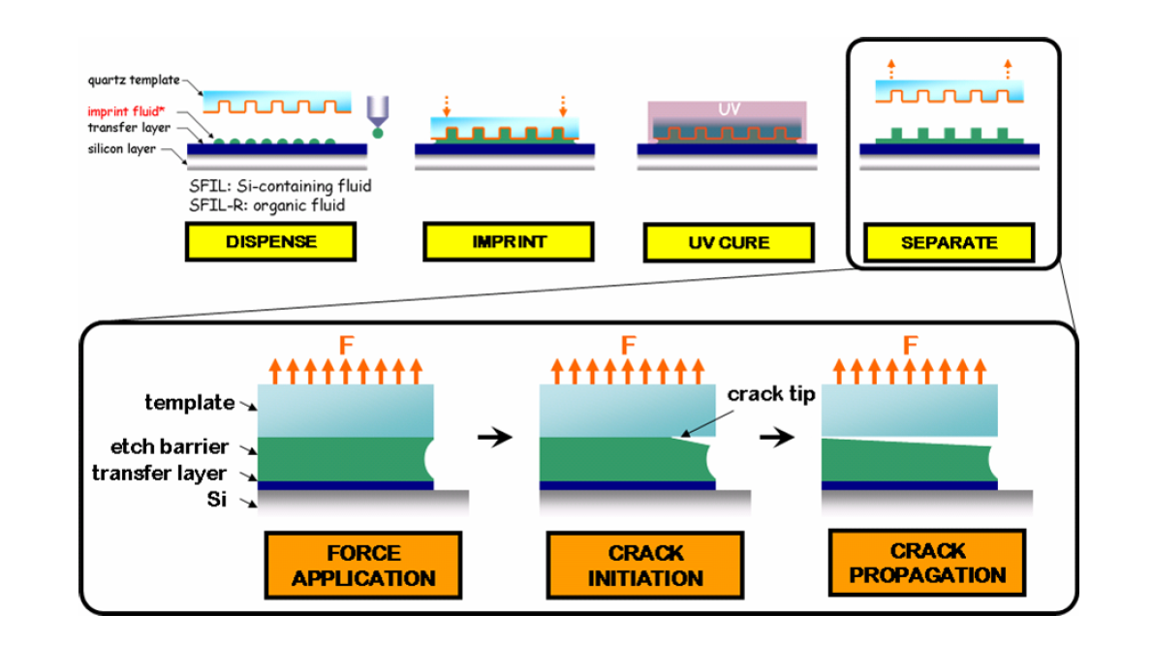
Template Release issues

Slide 15
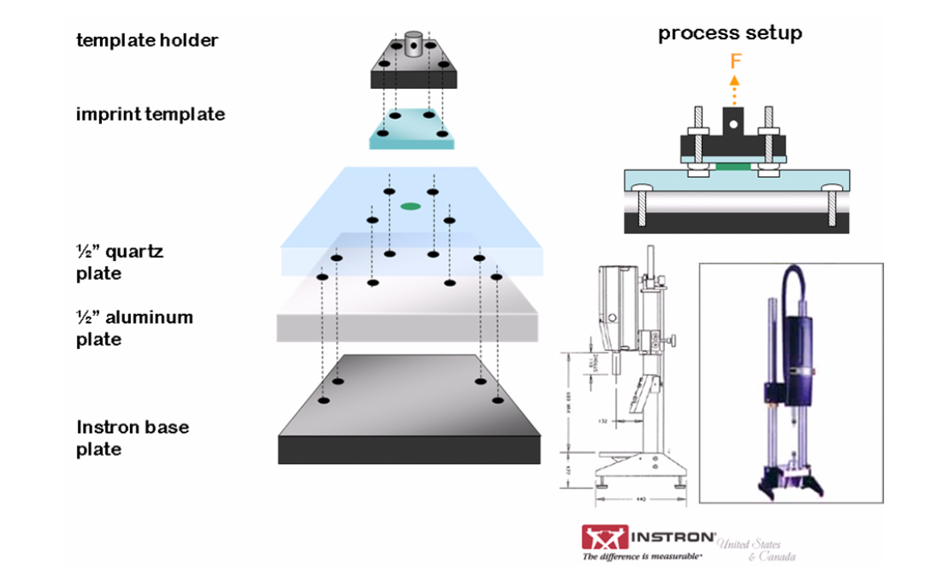
Adhesion Test Tool

Slide 16
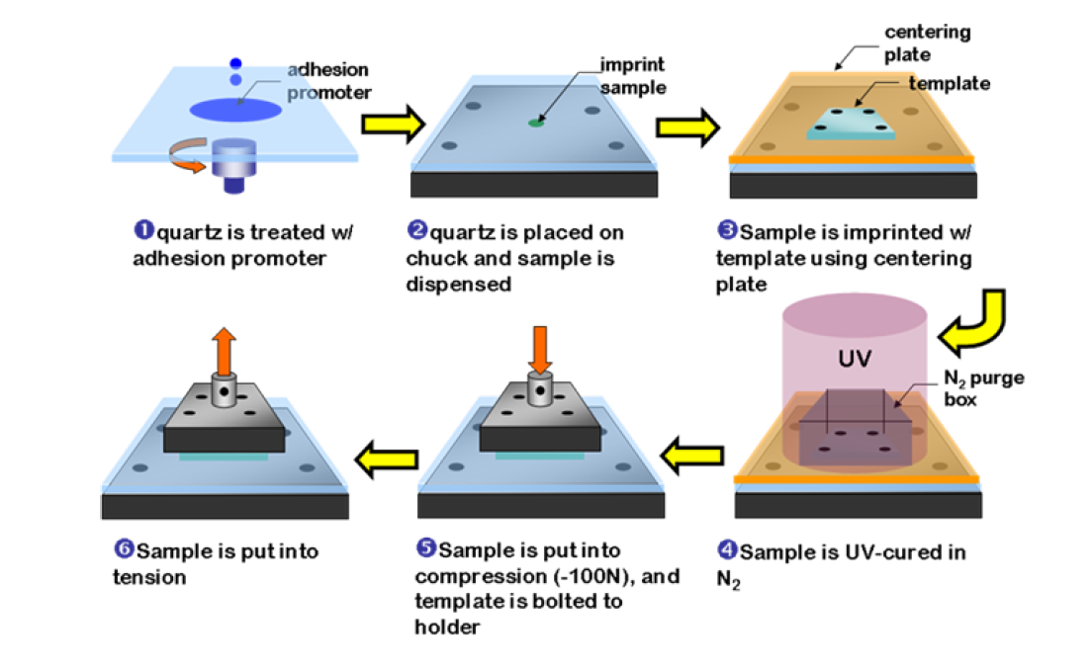
Imprint on an Instron

Slide 17
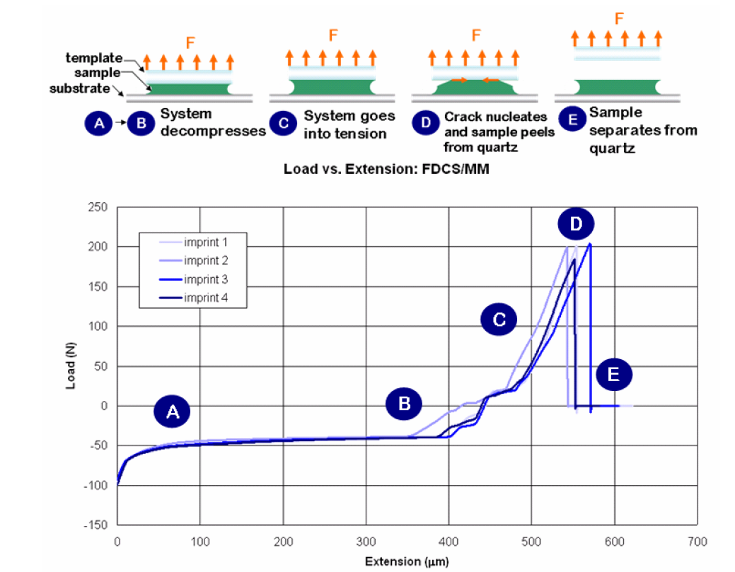
Instron Experiment

Slide 18
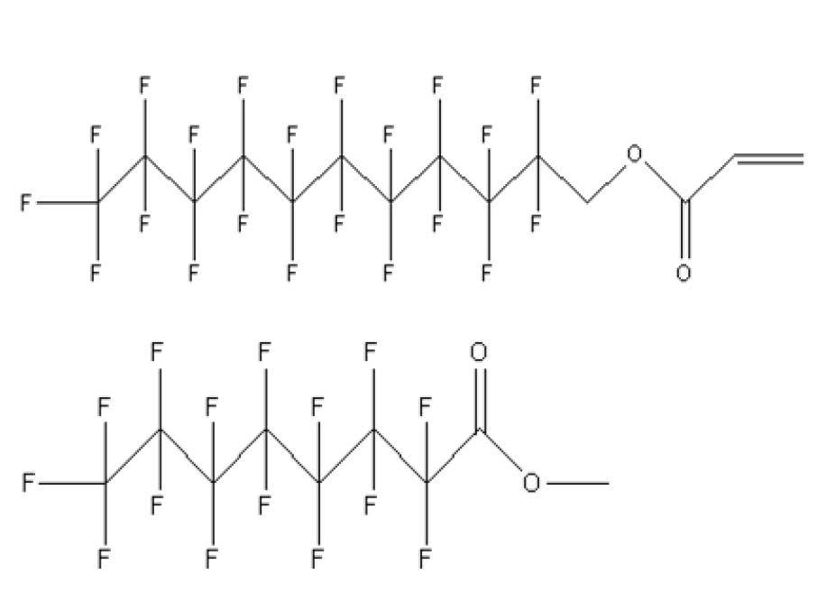
Fluorosurfactant additives
2-(Perfluorodecyl)ethyl acrylate (R)
Methyl perfluorooctanoate (NR)

Slide 19
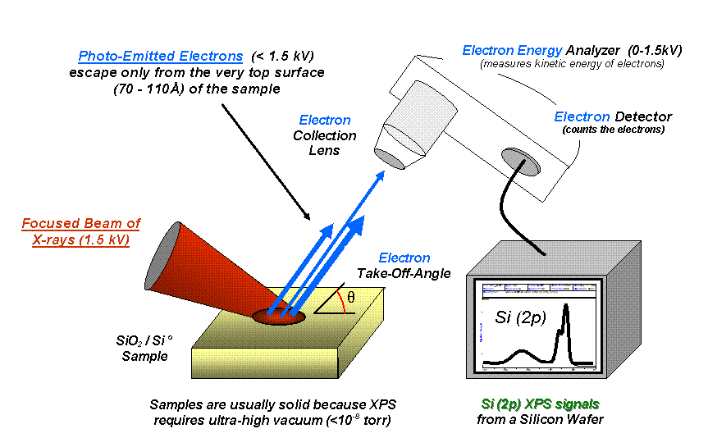
XPS or ESCA analysis
XPS X-ray photoelectron spectroscopy
ESCA (electron spectroscopy for chemical analysis)

Slide 20
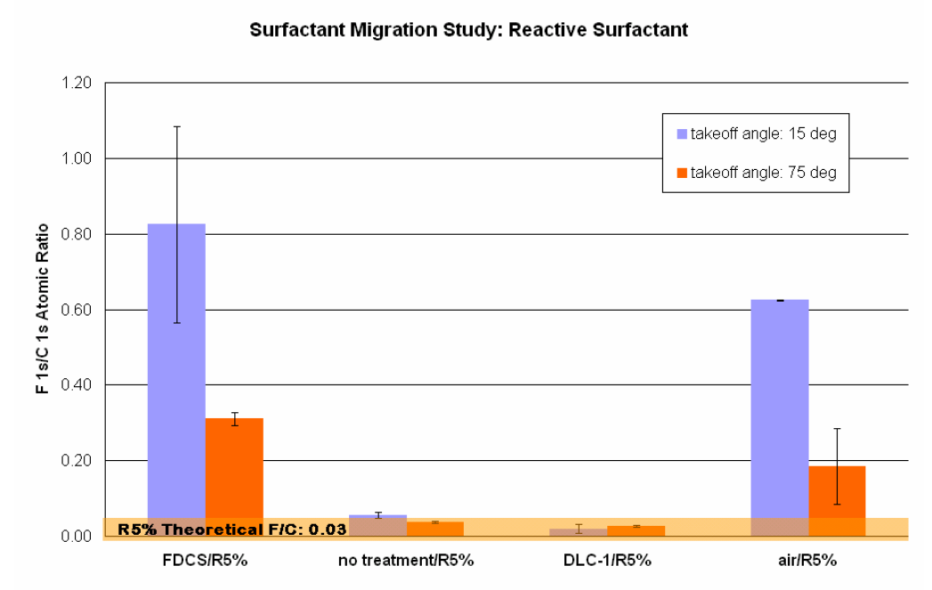

Slide 21
Contact angle and surface energy
goniometer

Slide 22
Bad News!
120
100
80
60
Water contact angle (degree)
40
81 imprints maximum
20
0
0
10
20
30
40
50
60
70
80
90
100
The numbers of imprints

Slide 23
We have a “wear” problem
Current solution & a problem
Fluorinated Self Assembly Monolayer (F-SAM)
Imprints
Degradation & defects !!

Slide 24
Solution to the “wear” problem
A reactive surfactant
Comparable structure to F-SAM !!!
HMDS
Fluorinated silazane
Concept
F-SAM
Imprints
w/ F-silazane
Imprints
Degraded …
Replenish !!!

Slide 25
Multiple Imprints Results
100 shots
possible more imprints
81 shots
hard more imprints
Water contact angle (degree)
The numbers of imprints

Slide 26
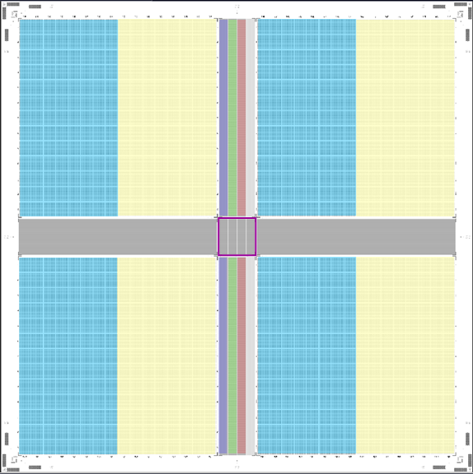
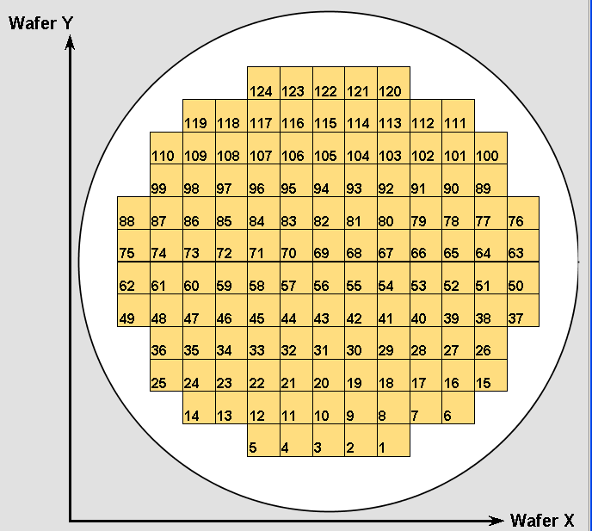
10,000 non-stop Imprints for one Template
Imprinted 82 - 200mm wafers with 124 fields per wafer
Wafers were imprinted with 13 mm X 13 mm mask fields
The imprints had no unprinted streets between the imprints
No process disruptions due to particles were observed
Do not know of any limitations, we could have printed more fields
Defect Template
Wafer layout

